Slide 1




JavaScript Development Introduction
First Steps in JavaScript
Svetlin Nakov
Technical Trainer
www.nakov.com
Software University
http://softuni.bg

Slide 2

Table of Contents
Dynamic HTML (DHTML)
Introduction to JavaScript
JavaScript in Web Pages
Integrating JavaScript in HTML
First Steps in JavaScript
JavaScript Syntax
Browser and JavaScript Objects
Debugging in JavaScript

Slide 3


Warning: Not for Absolute Beginners
The "JavaScript Basics" course is NOT for absolute beginners
Take the "C# Basics" course at SoftUni first: https://softuni.bg/courses/csharp-basics
The course is for beginners, but requires previous coding skills
Requirements
Coding skills – entry level
Computer English – entry level
Logical thinking
coding skills
required!

Slide 4

Dynamic HTML
Dynamic Behavior at the Client Side

Slide 5



What is DHTML?
DHTML: collection of technologies used together to create interactive web sites
Web pages to react and change in response to the user’s actions
DHTML is combination of HTML + CSS + JavaScript + DOM
DHTML
HTML
CSS
JavaScript
DOM

Slide 6
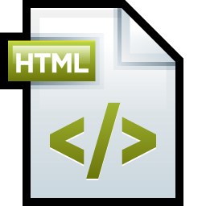
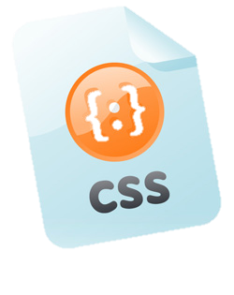
DHTML = HTML + CSS + JavaScript
HTML defines web sites content through semantic tags (headings, sections, articles, paragraphs, lists, …)
CSS describes the look and formatting of a document
Layout and Position of elements on the page
Presentation styles (background, borders, colors…)
Text and font styles (size, color, family)
JavaScript defines dynamic behavior
Programming logic for interaction with the user
Handle user events

Slide 7
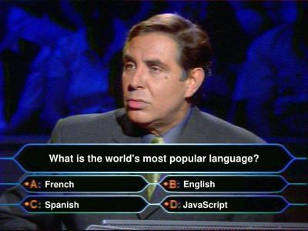

JavaScript
Dynamic Behavior in a Web Page

Slide 8
What is JavaScript?
JavaScript is a scripting programming language
Developed by Netscape for dynamic Web content
Lightweight, but with limited capabilities
Can be used as object-oriented language
Embedded in HTML page, interpreted by the Web browser
Client-side, server-side, mobile and desktop technology
Dynamic (scripting) language → weakly typed, runtime object alternation, functional programming, runtime code eval, etc.
Powerful to manipulate the DOM

Slide 9
JavaScript Advantages
JavaScript allows interactivity such as:
Dynamically load and change page content (through AJAX)
Implementing custom HTML UI controls
Sortable table, 3D charts, asynchronous file upload, …
Implementing advanced form validation
Respond to user actions, e.g. handle keyboard events
Performing complex calculations, e.g. SHA1 encryption
Implementing browser-based interactive games
Implementing Single Page Applications (SPA)

Slide 10
What Can JavaScript Do?
Can handle events, e.g. button clicks
Can read and write HTML elements and modify the DOM tree
Can access / modify browser cookies
Can detect the user’s browser and OS
Can be used as object-oriented language
Can perform asynchronous server calls (AJAX)
Can implement complex graphics / animation (through Canvas)
Can implement back-end logic (through Node.js)

Slide 11
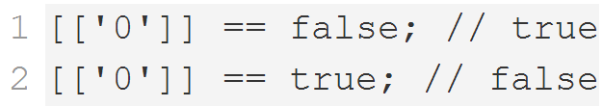
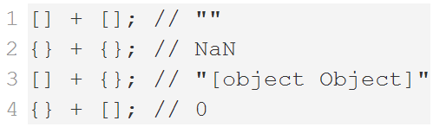
JavaScript Engines
JS engine – a virtual machine which interprets / executes JavaScript
Used in web Browsers
V8 in Chrome
Chakra in IE
Spidermonkey in Firefox
JavaScriptCore for Safari
Services
Memory management / GC
Just-in-Time compilation
Type System

Slide 12
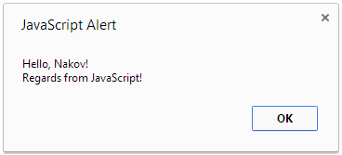
First Look at JavaScript Code
<html>
<body>
<script>
var name = "Nakov";
alert("Hello, " + name + "!\nRegards from JavaScript!");
</script>
</body>
</html>

Slide 13

First Look at JavaScript
Live Demo

Slide 14
Using JavaScript Code
The JavaScript code can be placed in:
<script> tag in the head
<script> tag in the body
External files (recommended), linked via <script src="…">
Files usually have .js extension
The .js files are cached by the browser
<script src="scripts.js" type="text/javscript">
<!– code placed here will not be executed! -->
</script>

Slide 15
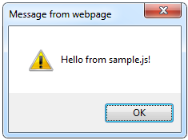
Using External Script Files
Using external JS files:
External JavaScript file (sample.js):
<html>
<head>
<script src="sample.js" type="text/javascript">
</script>
</head>
<body>
<button onclick="alertMessage()" value="Call JavaScript function from sample.js" />
</body>
</html>
external-JavaScript.html
The <script> tag is always empty. Cannot be <script … />.
function alertMessage() {
alert('Hello from sample.js!')
}
sample.js

Slide 16
Modern Approach to Load JS Files
Attributes (async and defer) load a script in background
Without pausing the HTML parser
async
Executed asynchronously as soon as the script is downloaded
Without blocking the browser in the meantime
defer
Executed in after the entire document has been loaded
<script src="scripts.js" async></script>
<script src="scripts.js" defer></script>

Slide 17
JavaScript – When is Executed?
JavaScript code is executed during the page loading or when the browser fires an event
All statements are executed at page loading
Some statements just define functions that can be called later
No compile-time checks (JavaScript is dynamic language)
Function calls or code can be attached as "event handlers"
Executed when the event is fired by the browser
<img src="softuni.gif" onclick="alert('Clicked!')" />

Slide 18
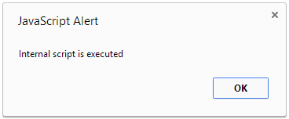
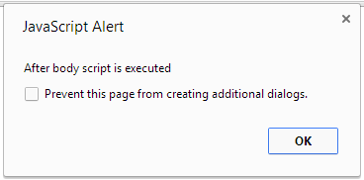
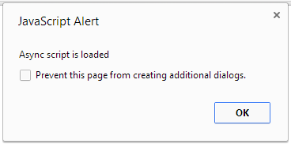
Executing JavaScript Code
Live Demo

Slide 19
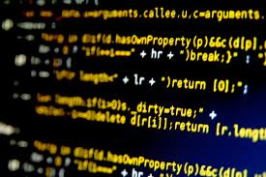

The JavaScript Syntax

Slide 20
JavaScript Syntax
The JavaScript syntax is similar to C#
Operators (+, *, =, !=, &&, ++, …)
Variables (typeless)
Conditional statements (if, else)
Loops (for, while)
Arrays (my_array[]) and associative arrays (my_array['abc'])
Functions (can return value)
Function variables (variables holding a function reference)

Slide 21
Standard Popup Boxes
Alert box with text and [OK] button
Just a message shown in a dialog box:
Confirmation box
Contains text, [OK] button and [Cancel] button:
Prompt box
Contains text, input field with default value:
alert("Some text here");
confirm("Are you sure?");
prompt ("enter amount", 10);

Slide 22
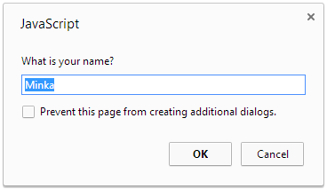
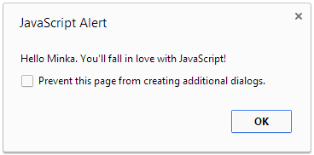
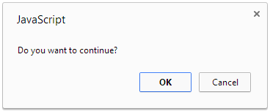
Syntax and Popup Boxes
Live Demo

Slide 23
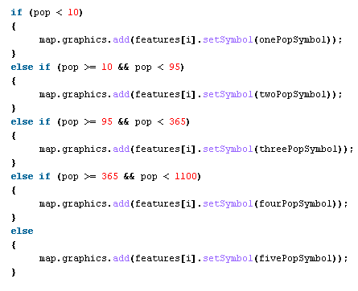
Event Handlers

Slide 24
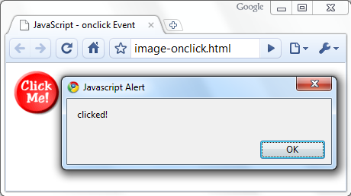
Calling a JavaScript Function from Event
<html>
<head>
<script type="text/javascript">
function test (message) {
alert(message);
}
</script>
</head>
<body>
<img src="logo.gif"
onclick="test('clicked!')" />
</body>
</html>

Slide 25
Event Handlers in JavaScript
Live Demo

Slide 26


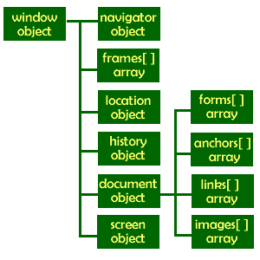
The Built-In Browser Objects

Slide 27
Built-in Browser Objects
The browser provides some read-only data via:
window
The top node of the DOM tree
Represents the browser's window
document
Holds information of the current loaded document
screen
Holds the user’s display properties
browser
Holds information about the browser

Slide 28
DOM Hierarchy – Example
window
navigator
screen
document
history
location
form
form
button
form

Slide 29
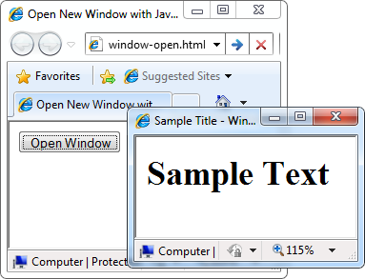
Opening New Window – Example
window.open()
window-open.html
var newWindow = window.open("", "sampleWindow", "width=300, height=100, menubar=yes, status=yes, resizable=yes");
newWindow.document.write(
"<html><head><title>
Sample Title</title>
</head><body><h1>Sample
Text</h1></body>");
newWindow.status =
"Hello folks";

Slide 30
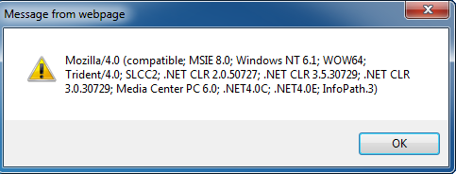
The Navigator Object
alert(window.navigator.userAgent);
The browser window
The navigator in the browser window
The userAgent (browser ID)

Slide 31

The Screen Object
The screen object contains information about the display
window.moveTo(0, 0);
x = screen.availWidth;
y = screen.availHeight;
window.resizeTo(x, y);

Slide 32
The Screen Object
document object
Provides some built-in arrays of specific objects on the currently loaded Web page
document.location
Used to access the currently open URL or redirect the browser
document.links[0].href = "yahoo.com";
document.write(
"This is some <b>bold text</b>");
document.location = "http://www.yahoo.com";

Slide 33
Built-In Browser Objects
Live Demo

Slide 34
Other JavaScript Objects

Slide 35
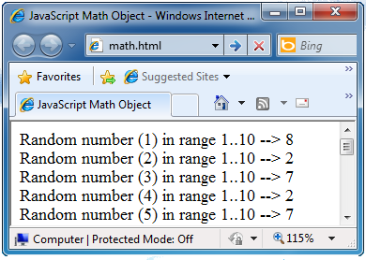
The Math Object
The Math object provides some mathematical functions
math.html
for (i=1; i<=20; i++) {
var x = Math.random();
x = 10*x + 1;
x = Math.floor(x);
document.write(
"Random number (" +
i + ") in range " +
"1..10 --> " + x +
"<br/>");
}

Slide 36
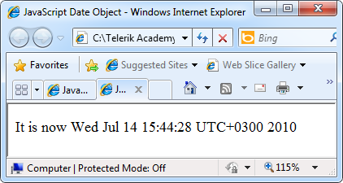
The Date Object
The Date object provides date / calendar functions
dates.html
var now = new Date();
var result = "The time is " + now;
document.getElementById("timeField").innerText = result;
...
<p id="timeField"></p>

Slide 37
Timers: setTimeout()
Make something happen (once) after a fixed delay
var timer = setTimeout('bang()', 5000);
5 seconds after his statement executes, this function is called
clearTimeout(timer);
Cancels the timer

Slide 38
Timers: setInterval()
Make something happen repeatedly at fixed intervals
var timer = setInterval('clock()', 1000);
This function is called continuously per 1 second.
clearInterval(timer);
Stops the timer.

Slide 39
Timer – Example
timer-demo.html
<script type="text/javascript">
function timerFunc() {
var now = new Date();
var hour = now.getHours();
var min = now.getMinutes();
var sec = now.getSeconds();
document.getElementById("clock").value =
"" + hour + ":" + min + ":" + sec;
}
setInterval('timerFunc()', 1000);
</script>
<input type="text" id="clock" />

Slide 40
Other JavaScript Objects
Live Demo

Slide 41

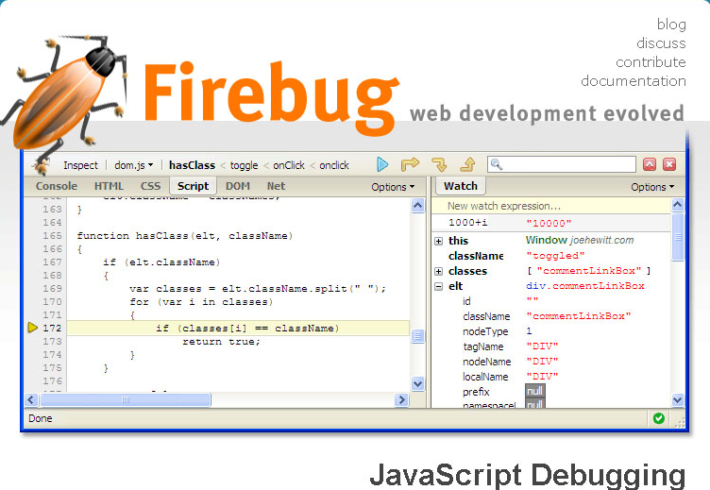
Debugging JavaScript

Slide 42
Debugging JavaScript
Modern browsers have JavaScript console where errors in scripts are reported
Errors may differ across browsers
Several tools to debug JavaScript
Microsoft Script Editor
Add-on for Internet Explorer
Supports breakpoints, watches
JavaScript statement debugger; opens the script editor

Slide 43
Firebug
Firebug
Firefox add-on for debugging JavaScript, CSS, HTML
Supports breakpoints, watches, JavaScript console editor
Very useful for CSS and HTML too
You can edit all the document real-time: CSS, HTML, etc
Shows how CSS rules apply to element
Shows Ajax requests and responses
Firebug is written mostly in JavaScript

Slide 44
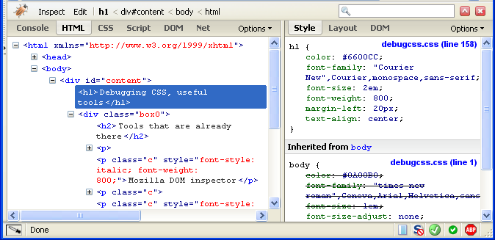
Firebug (2)

Slide 45
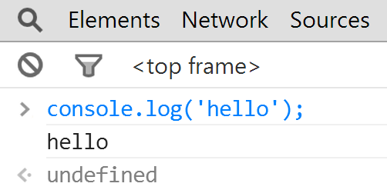
JavaScript Console Object
The console object exists only if there is a debugging tool that supports it
Used to write log messages at runtime
Methods of the console object:
debug(message)
info(message)
log(message)
warn(message)
error(message)

Slide 46


Summary
DHTML = HTML + CSS + JavaScript + DOM
JavaScript – dynamical scripting language
Executed in the Web browsers
Enables dynamic behavior
The DOM hierarchy
window, document, body, form, …
Debugging JS code
JS console, Firebug, [F12]
JS Basics

Slide 47
JavaScript Development Introduction
https://softuni.bg/courses/javascript-basics/

Slide 48
License
This course (slides, examples, demos, videos, homework, etc.) is licensed under the "Creative Commons Attribution-NonCommercial-ShareAlike 4.0 International" license
Attribution: this work may contain portions from
“JavaScript Basics" course by Telerik Academy under CC-BY-NC-SA license

Slide 49





Free Trainings @ Software University
Software University Foundation – softuni.org
Software University – High-Quality Education, Profession and Job for Software Developers
softuni.bg
Software University @ Facebook
facebook.com/SoftwareUniversity
Software University @ YouTube
youtube.com/SoftwareUniversity
Software University Forums – forum.softuni.bg

